Slide 1
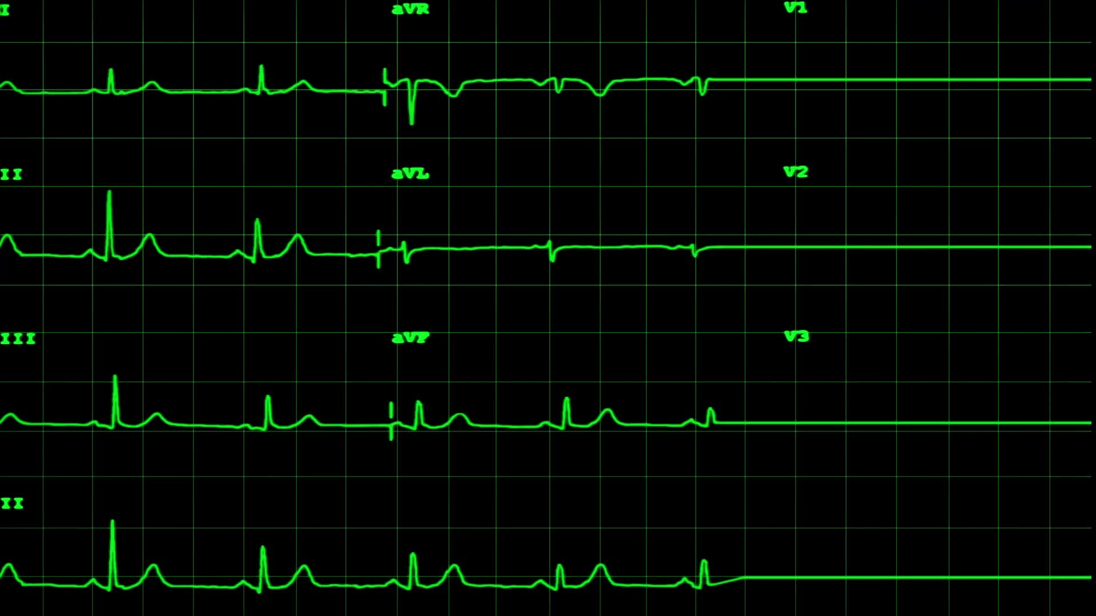
heart disease prediction and ideentification with deep learning on neural networks
Presented by
Rakesh Narapareddy 700758254
Rishikesh Katta 700742487

Slide 2

Role/Responsibilities and Contribution in Project
Processing and also designing, building and training neural network model - Rishikesh Katta.
Overall planning and data collection also analysis - Rakesh Narapareddy.

Slide 3

Motivation
The Deep learning will be the python based application which contributes to find out the heart disease early stage . It will be helpful for the human to detect at early and to take necessary treaments in the correct time.
The process begins with the application taking in various inputs, such as patient information, medical history, lifestyle factors, and diagnostic test results. This data is collected from electronic health records, wearable devices, or user input.
Next, the input data undergoes preprocessing using Python libraries like NumPy, Pandas, and scikit-learn. This involves cleaning the data, handling missing values, and preparing it in a format suitable for analysis.
The application then focuses on extracting and selecting relevant features from the data. While deep learning models can automatically learn features, ensuring the inclusion of pertinent information is crucial for accurate heart disease detection.

Slide 4
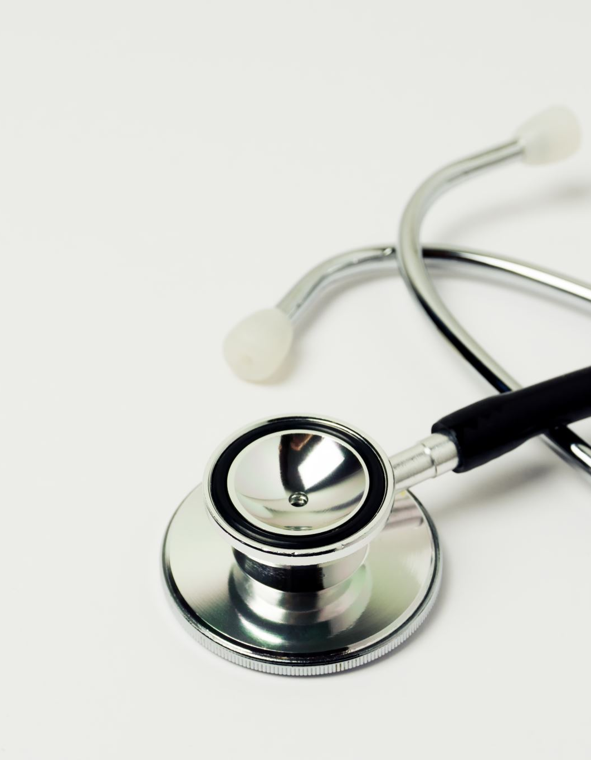
Objectives
The objective of heart disease identification with deep learning is to detect the heart disease in the early stage itslef with the available attributes. In this work , the dataset containing the heart disease will be taken into consideration[1][6]. The pre-processing will be applied in to the dataset and the noisy and null value data will be removed from the dataset. After the data will be analyzed and visualized for further processing. The Deep learning algorithm will be choosed to make the prediction.
The dataset will be divided into two parts. The first part of dataset is 70% taken to provide training to the Deep learning alogrithm and the remiaing 30% of data is taken to testing part.

Slide 5
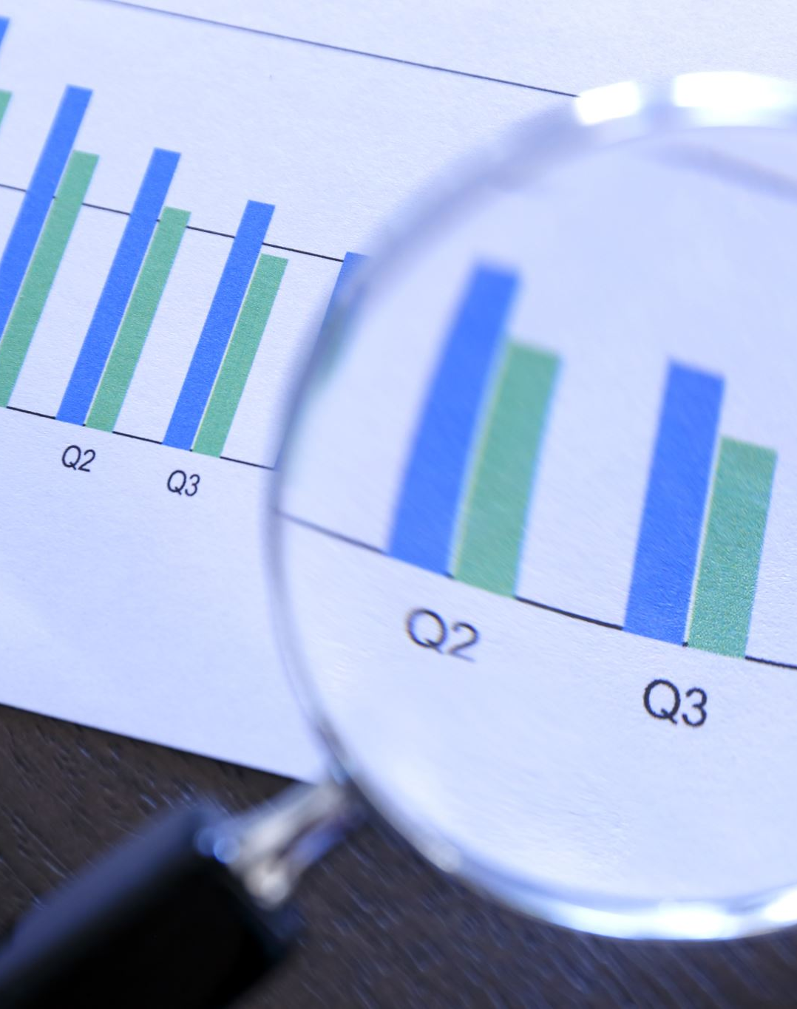
Analysis of Heart Disease prediction:
It will begin from the principal segment and investigate every section and comprehend what influence it makes on the objective segment. At the necessary step, we will likewise perform preprocessing and include designing undertakings. The point in acting top to bottom exploratory examination is to get ready and clean information for better Deep Learning demonstrating to accomplish elite execution and summed up models. So it should begin with breaking down and setting up the dataset for expectation.
Modules:
1) Dataset collection
2) Data cleaning
3) Data Analysis
4) Deep learning Modeling
5) Report

Slide 6
Problem Statement
Heart-related diseases are among the most widely recognized reasons for death around the world. Patients are frequently asymptomatic until a deadly occasion occurs, and in any event, when they are under perception, prepared work force is required to recognize a heart abnormality. Somewhat recently, there has been expanding proof of how deep learning can be utilized to recognize such oddities, because of the accessibility of Electrocardiograms (ECG) in computerized design. New advancements in innovation have permitted to take advantage of such information to fabricate models ready to dissect the examples in the event of heart beats, and spot abnormalities from them. In this work, master cardiologists across various clinics and nations, and can recognize 7 sorts of signs: Typical, AF, Tachycardia, Bradycardia, Arrhythmia, Other or Boisterous.

Slide 7

Proposed Solutions
The task included examination of the heart disease patient dataset with appropriate information handling. Then, at that point, various models were prepared and expectations are made with Deep Learning model. The machine learning library and deep learning libraries Sklearn and Keras' are applied into the application.
In this work , the dataset containing the heart disease will be taken into consideration[1][6]. The pre-processing will be applied in to the dataset and the noisy and null value data will be removed from the dataset. After the data will be analyzed and visualized for further processing. The Deep learning algorithm will be choosed to make the prediction.
The dataset will be divided into two parts. The first part of dataset is 70% taken to provide training to the Deep learning alogrithm and the remiaing 30% of data is taken to testing part.

Slide 8

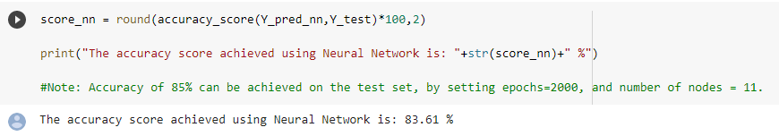
Results
Here we can see the accuracy as 83.61%.

Slide 9

References
[1]. Samiul based shuvo 1, shams nafisa ali 1, (student member, ieee), soham irtiza swapnil1, mabrook s. al-rakhami 2, (senior member, ieee), and abdu gumaei “CardioXNet: A Novel Lightweight Deep Learning Framework for Cardiovascular Disease Classification Using Heart Sound Recordings”. February 24, 2021, date of publication March 2, 2021, date of current version March 9, 2021.IEEE.
[2]. Eun s. lee 1, (member, ieee), byeong g. choi 2, (member, ieee), myung y. kim1, (Member, IEEE), AND SEUNG H. HAN 3, (Member, IEEE)” An Imbalanced-DataProcessingAlgorithmforthe Prediction of Heart Attack in Stroke Patients”. January 14, 2021, date of publication February 8, 2021, date of current version February 16, 2021, IEEE.
[3]. Hao ren2,1∗ aslan b. wong1∗, wanmin lian3∗, weibin cheng2, ying zhang1, jianwei he1. “Interpretable Pneumonia Detection by Combining Deep Learning and Explainable Models with

